Slide 1
Docker/Kubernetes Demo
Quick overview of Docker/Kubernetes principles and practices
Monica Marshall 9/23/2020
Demo: https://github.com/monicamarshall/MessageBoardApp

Slide 2
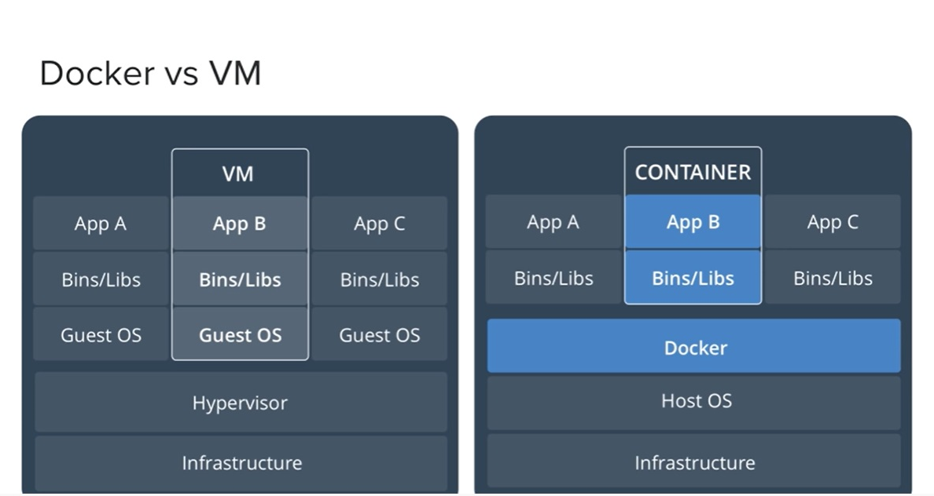
Docker vs VM

Slide 3
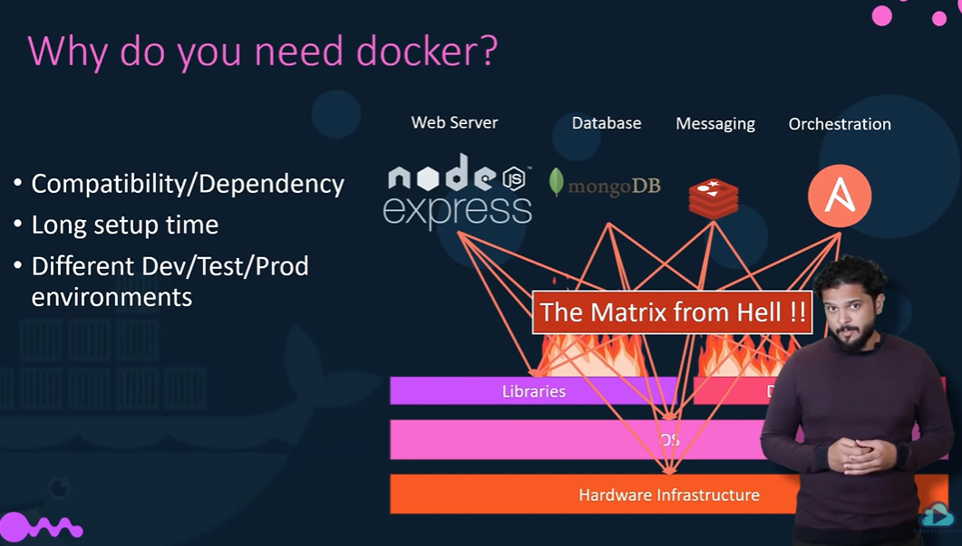
Why Docker? From hell …

Slide 4
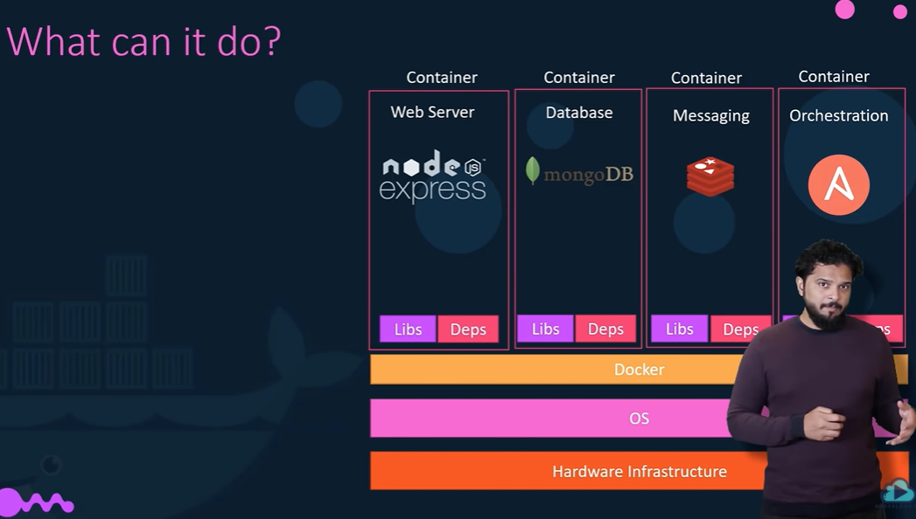
…To Heaven

Slide 5
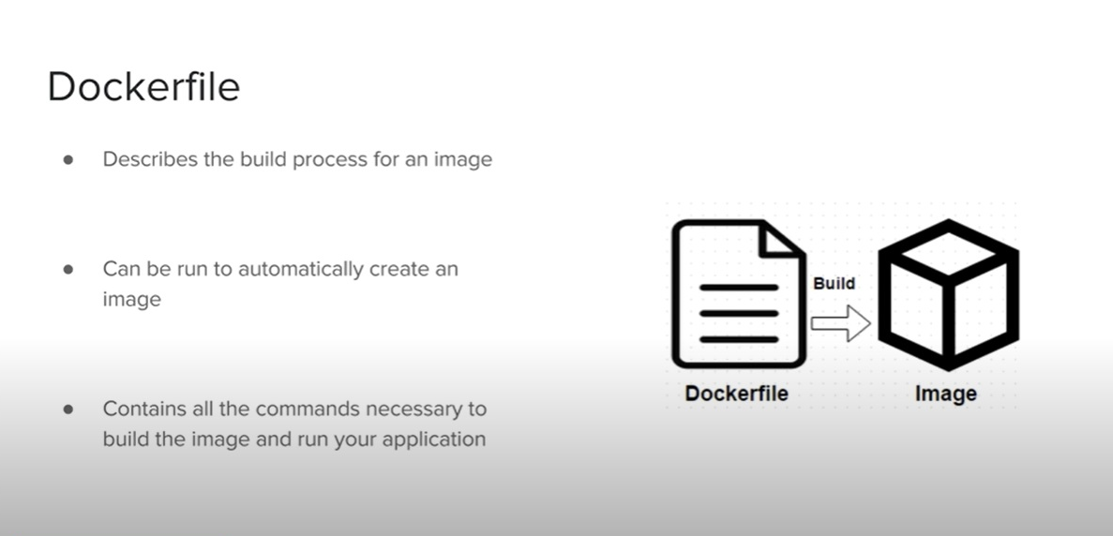
Dockerfile/Docker image

Slide 6
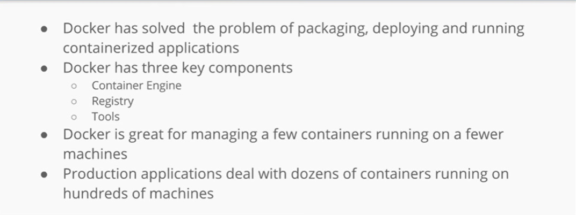
Why Docker?

Slide 7
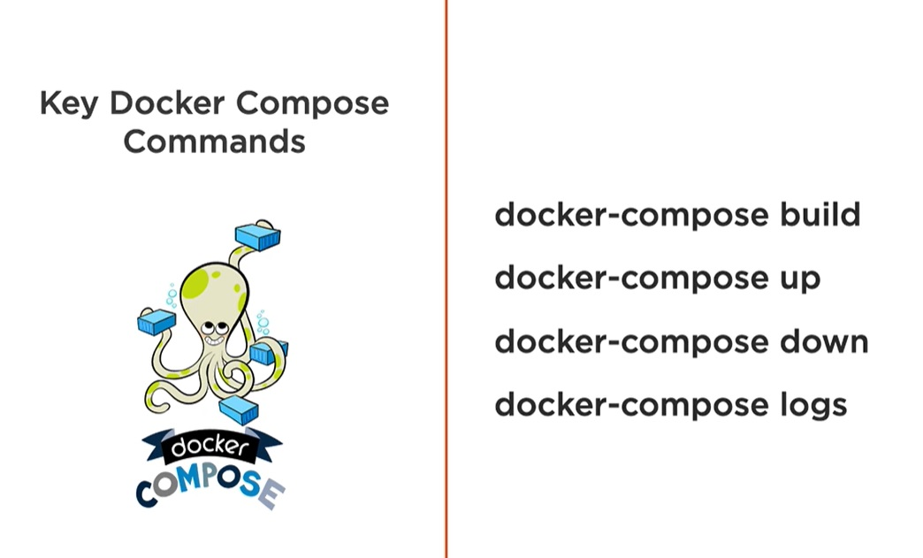
Docker-compose

Slide 8
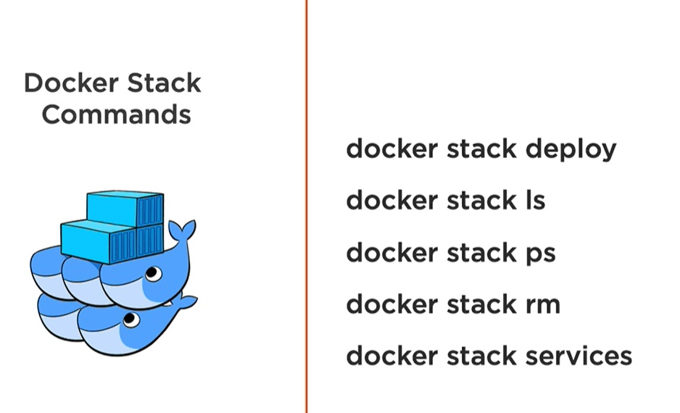
Docker stack

Slide 9
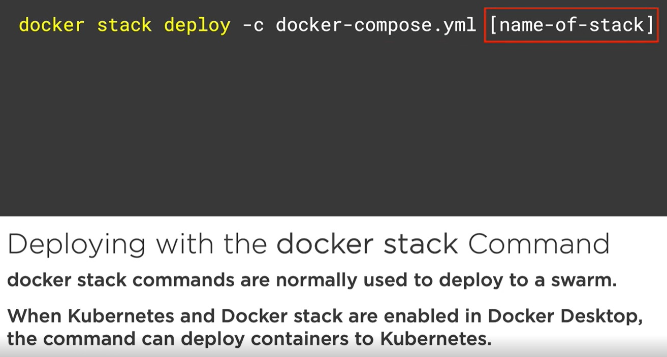
Docker stack command

Slide 10
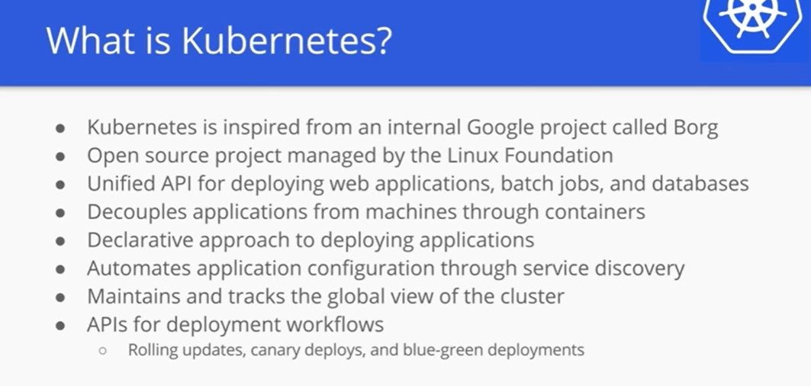
What is Kubernetes?

Slide 11
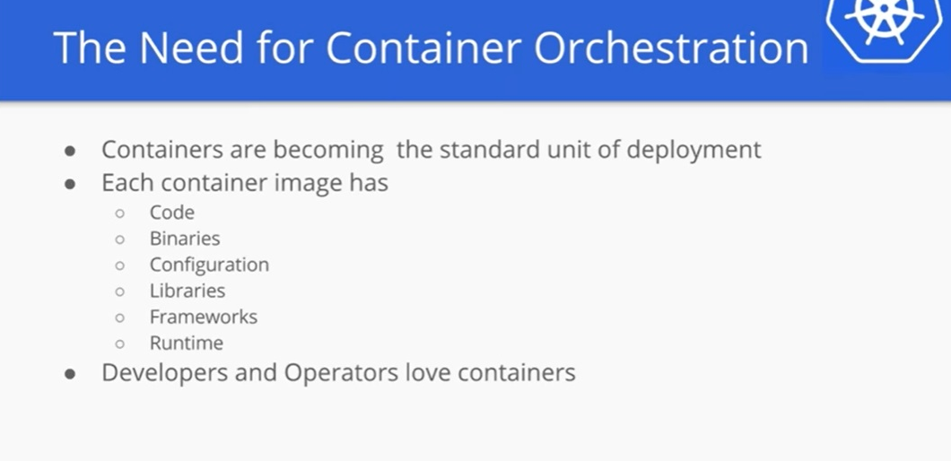
Need for Container Orchestration

Slide 12
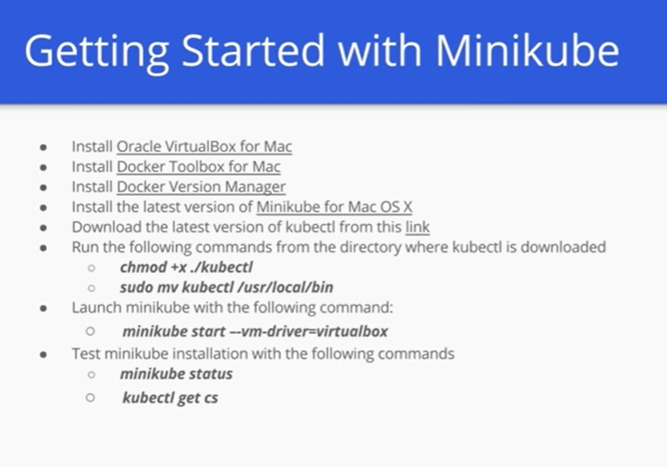
Getting started

Slide 13
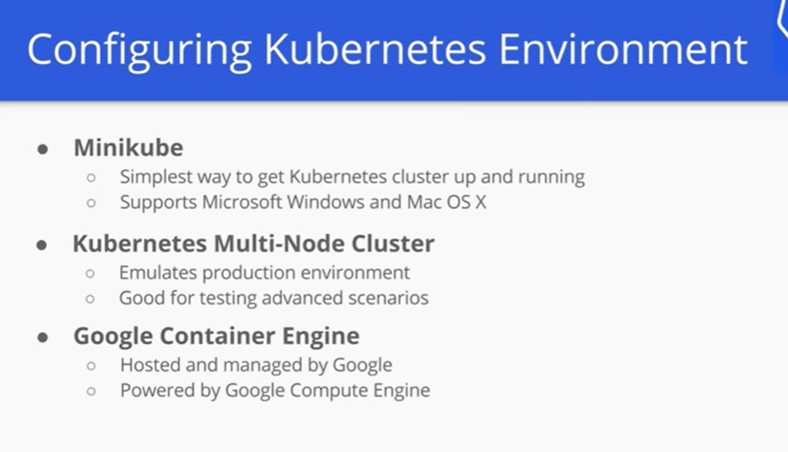
Configure Kubernetes

Slide 14
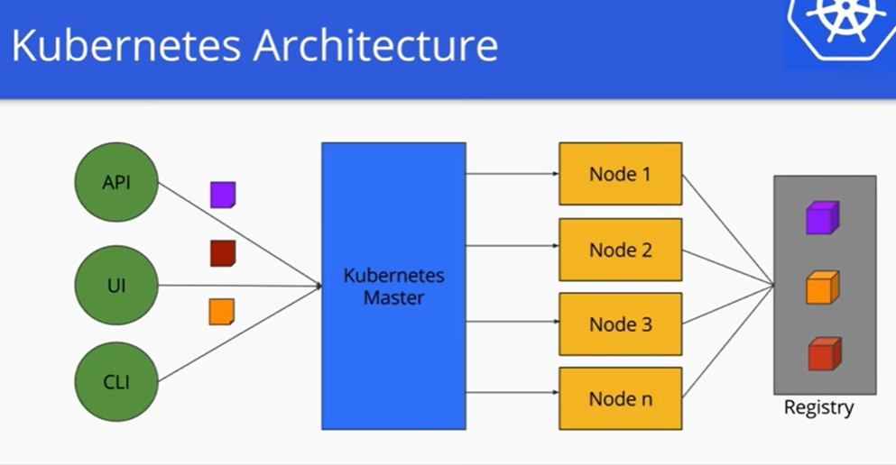
Kubernetes Architecture

Slide 15
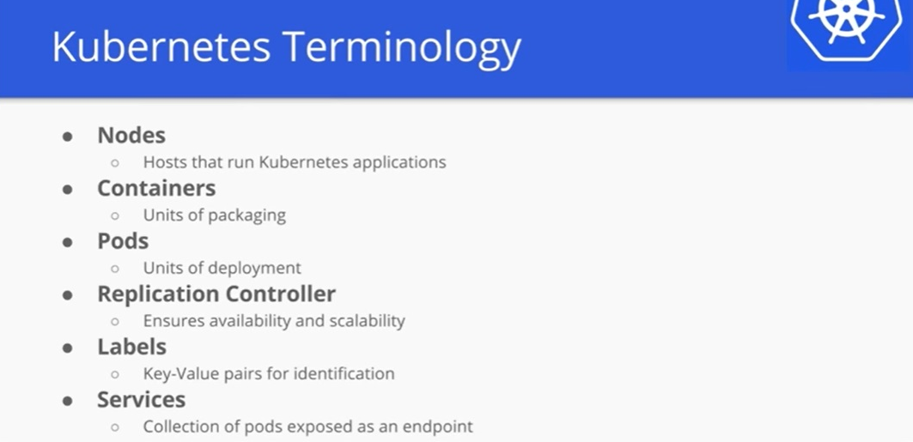
Kubernetes Terminology

Slide 16
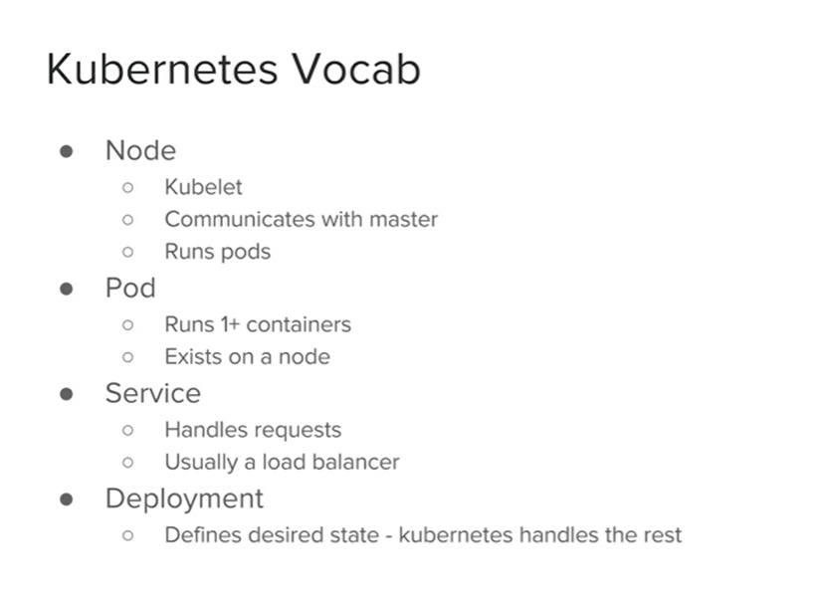
Kubernetes Vocab

Slide 17
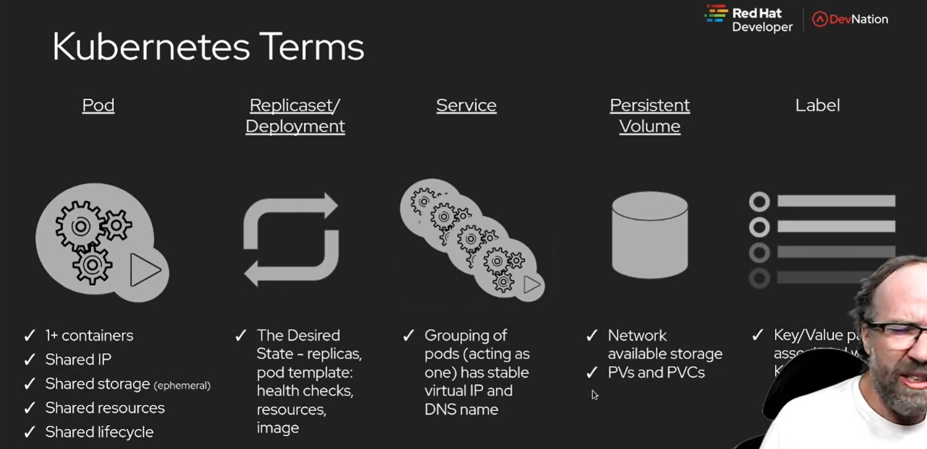
Kubernetes Terms

Slide 18
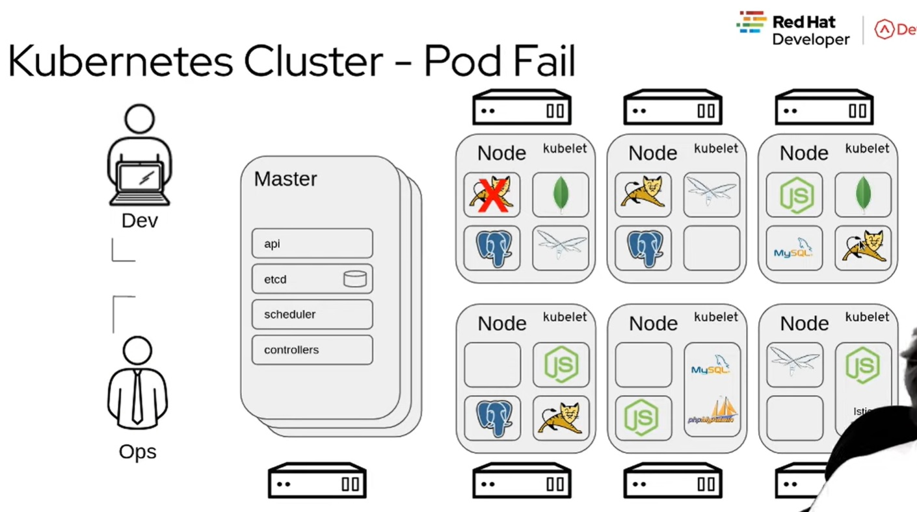
Kubernetes cluster

Slide 19
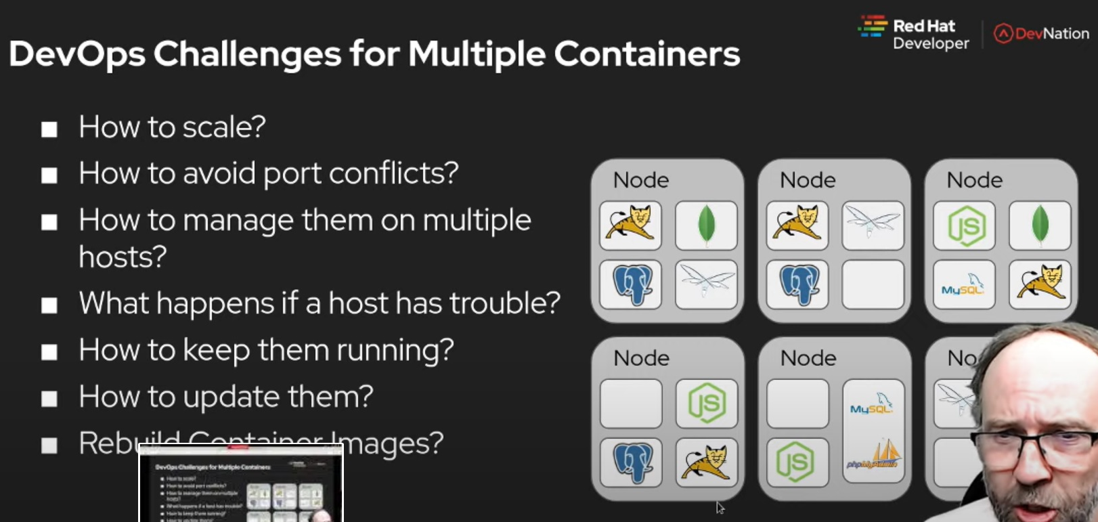
Challenge for multi-container env

Slide 20
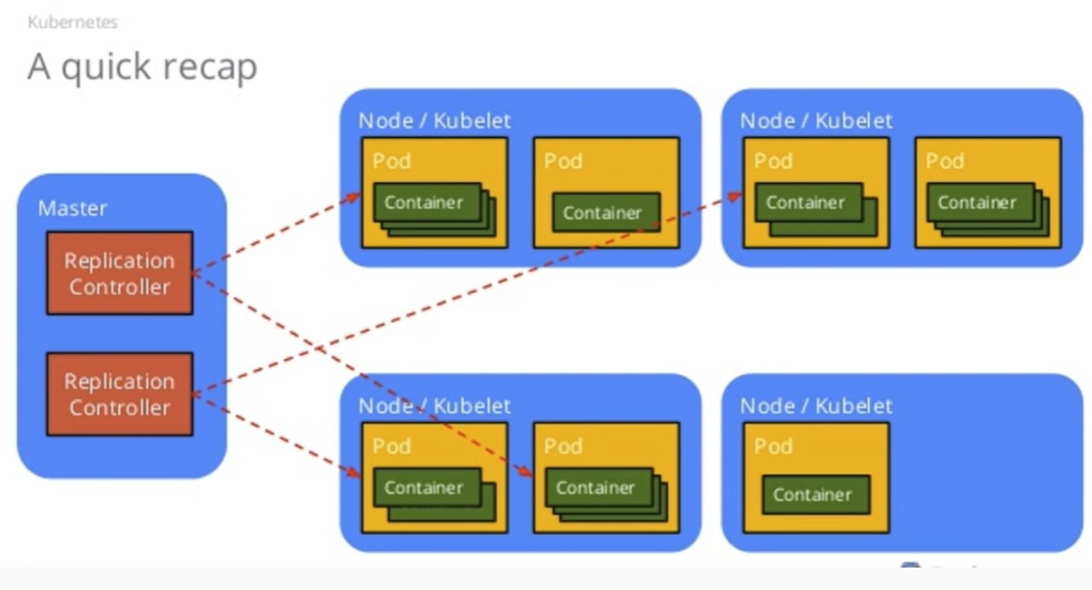
Quick Recap

Slide 21
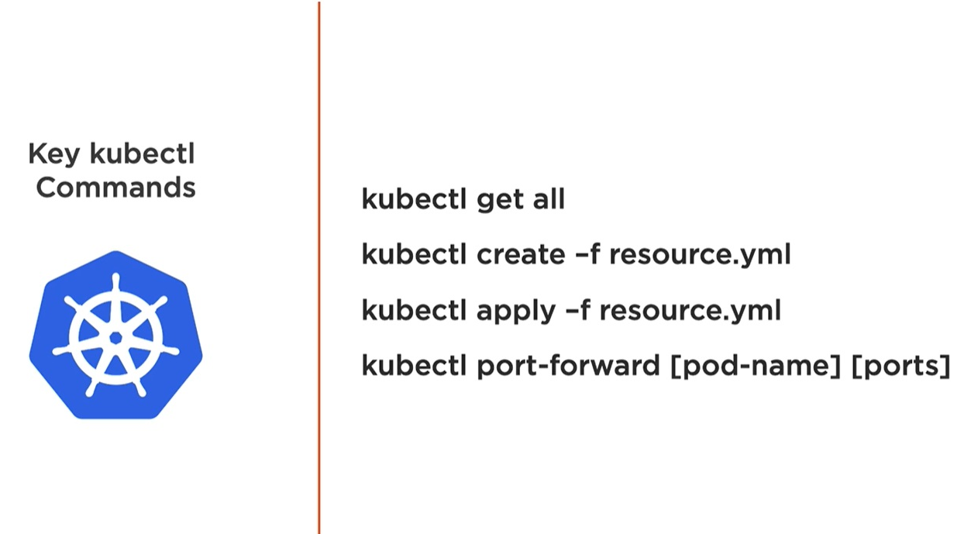
Kubectl commands

Slide 22
Kubernetes Ingress vs LoadBalancer vs NodePort
They all allows access to your Kubernetes services from outside the Kubernetes cluster.
Ingress consolidates routing rules into a single resource yaml file, such as path example.com/api/v1/ to an api-v1 service, and path example.com/api/v2/ to the api-v2 service. It is a completely independent resource to your service. You declare, create and destroy it separately from your services.

Slide 23
NGINX INGRESS
The nginx ingress controller comprises:
An ingress controller deployment called nginx-ingress-controller. The deployment deploys an image that contains the binary for the ingress controller and Nginx. The binary manipulates and reloads the /etc/nginx/nginx.conf configuration file when an ingress is created in Kubernetes. Nginx upstreams point to services that match specified selectors.
An ingress controller service called ingress-nginx. The service exposes the ingress controller deployment as a LoadBalancer type service.

Slide 24
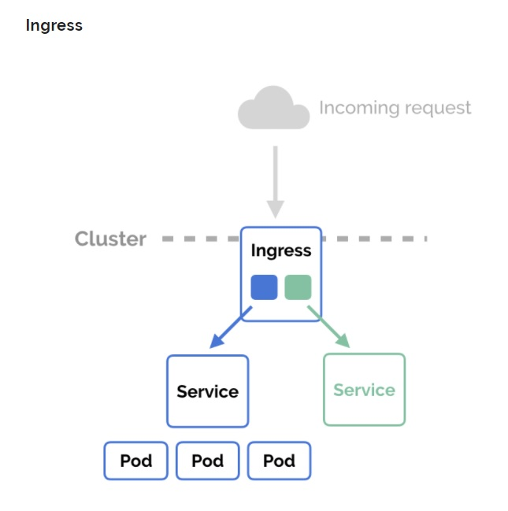
Ingress

Slide 25
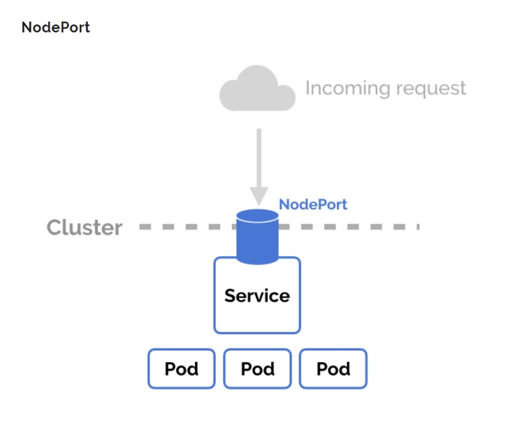
NodePort

Slide 26
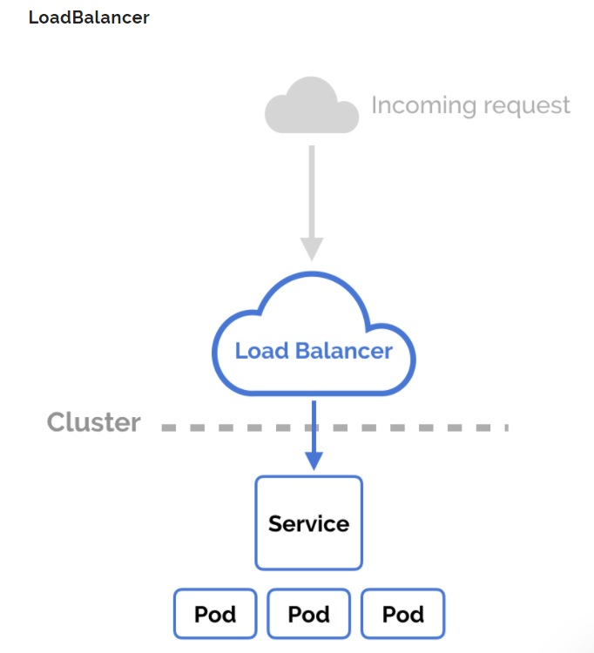
LoadBalancer

Slide 27
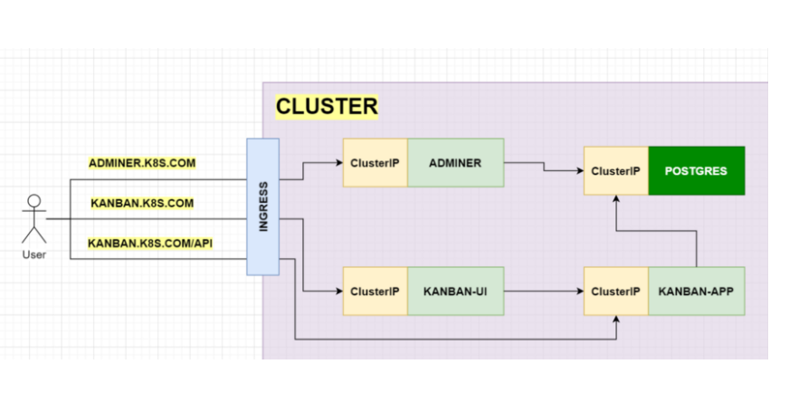
Ingress Architecture example

Slide 28
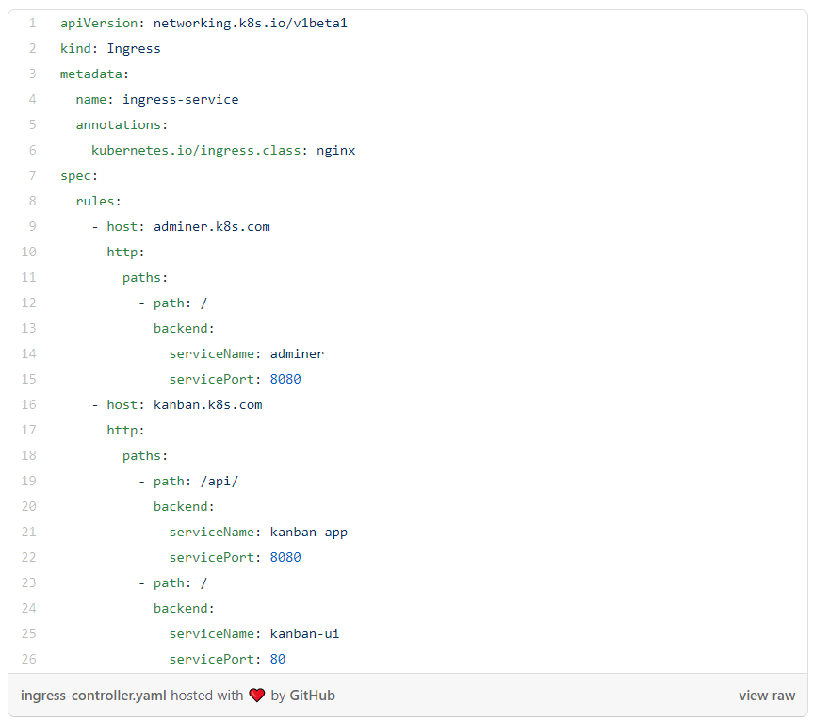
Example Ingress yaml file

Slide 29
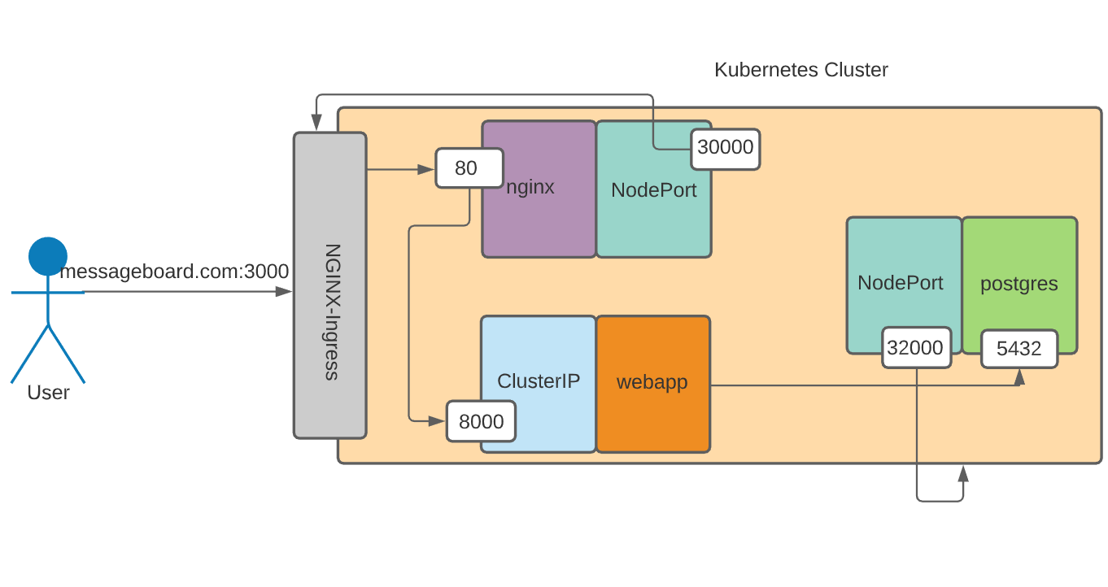
MessageBoardApp k8s architecture

